Slide 1
Principle and operation of Single Phase Transformer

Slide 2
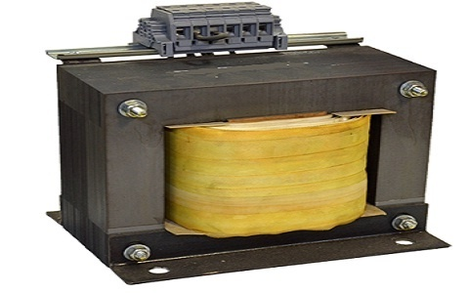
A transformer is a static device that transfers electric power in one circuit to another circuit of the same frequency.
A transformer is a device which converts magnetic energy into electrical energy.
It consists of primary and secondary windings. This transformer operates on the principle of mutual inductance.
The primary winding of a transformer receives power, while the secondary winding delivers power.
A magnetic iron circuit called “core” is commonly used to wrap around these coils. Though these two coils are electrically isolated, they are magnetically linked.
Based on how the windings are wound around the central steel laminated core, the transformer construction is divided into two types

Slide 3
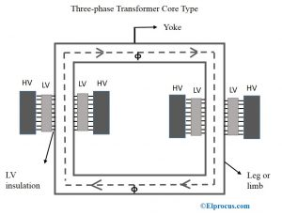
Core-type Transformer
In this type of construction, only half of the windings are wound cylindrically around each leg of a transformer to enhance magnetic coupling as shown in the figure below.
This type of construction ensures that magnetic lines of force flow across both the windings simultaneously.
The main disadvantage of the core-type transformer is the leakage flux that occurs due to the flow of a small proportion of magnetic lines of force outside the core

Slide 4
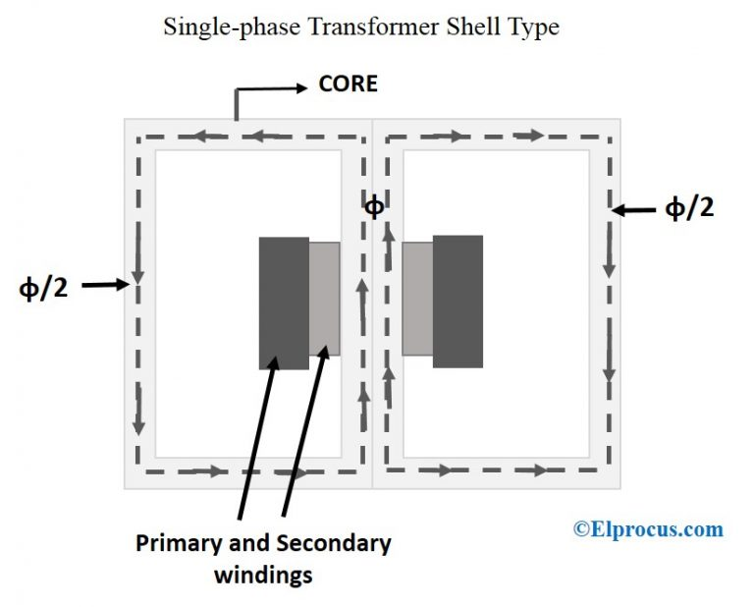
Shell-type Transformer
In this type of transformer construction, the primary and secondary windings are positioned cylindrically on the center limb resulting in twice the cross-sectional area than the outer limbs.
There are two closed magnetic paths in this type of construction and the outer limb has the magnetic flux ɸ/2 flowing. Shell type transformer overcomes leakage flux, reduces core losses and increases efficiency

Slide 5
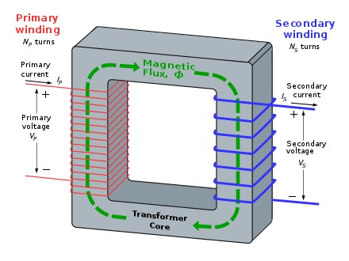
Principle of Single Phase Transformer
The single-phase transformer works on the principle of Faraday’s Law of Electromagnetic Induction. Typically, mutual induction between primary and secondary windings is responsible for the transformer operation in an electrical transformer.

Slide 6
Working of Single Phase Transformer
When the primary of a transformer is connected to an AC supply, the current flows in the coil and the magnetic field build-up.
This condition is known as mutual inductance and the flow of current is as per the Faraday’s Law of electromagnetic induction. As the current increases from zero to its maximum value, the magnetic field strengthens and is given by dɸ/dt.
This electromagnet forms the magnetic lines of force and expands outward from the coil forming a path of magnetic flux.
The turns of both windings get linked by this magnetic flux
The strength of a magnetic field generated in the core depends on the number of turns in the winding and the amount of current
The magnetic flux and current are directly proportional to each other.

Slide 7
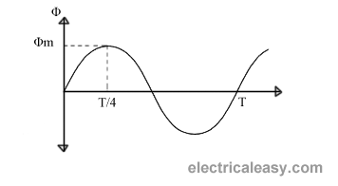
EMF equation of the Transformer
Let, N₁ = Number of turns in primary winding N₂ = Number of turns in secondary winding Φ_{m} = Maximum flux in the core (in Wb) = (B_{m} x A) f = frequency of the AC supply (in Hz)
As, shown in the fig., the flux rises sinusoidally to its maximum value Φ_{m} from 0. It reaches to the maximum value in one quarter of the cycle i.e in T/4 sec (where, T is time period of the sin wave of the supply = 1/f).
Therefore, average rate of change of flux = ^{Φ}_{m} /_{(T/4)} = ^{Φ}_{m} /_{(1/4f)} Therefore, average rate of change of flux = 4f Φ_{m} ....... (Wb/s).

Slide 8

Now, Induced emf per turn = rate of change of flux per turn
Therefore, average emf per turn = 4f Φ_{m} ..........(Volts).
Now, we know, Form factor = RMS value / average value Therefore, RMS value of emf per turn = Form factor X average emf per turn. As, the flux Φ varies sinusoidally, form factor of a sine wave is 1.11 Therefore, RMS value of emf per turn = 1.11 x 4f Φ_{m} = 4.44f Φ_{m}. RMS value of induced emf in whole primary winding (E₁) = RMS value of emf per turn X Number of turns in primary winding E₁ = 4.44f N₁ Φ_{m} ............................. eq 1
Similarly, RMS induced emf in secondary winding (E₂) can be given as
E₂ = 4.44f N₂ Φ_{m}. ............................ eq 2 from the above equations 1 and 2,
This is called the emf equation of transformer, which shows, emf / number of turns is same for both primary and secondary winding. For an ideal transformer on no load, E₁ = V₁ and E₂ = V₂ . where, V₁ = supply voltage of primary winding V₂ = terminal voltage of secondary winding

